Slide 1
HECC 2018
Deploying Windows 10 With MDT

Slide 2
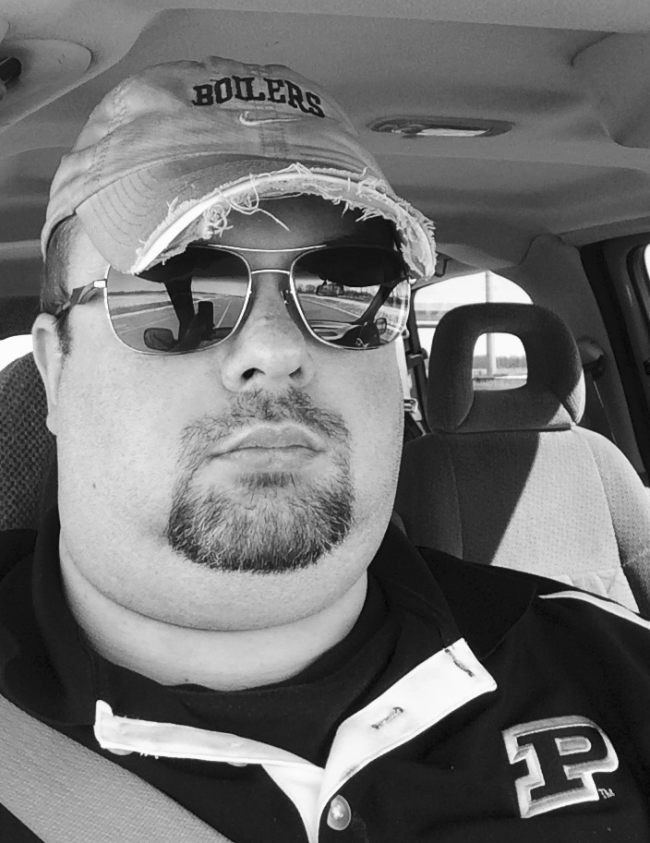
About Me
Network Engineer @ Huntington County Community School Corporation
Worked in IT for 15 + years
This is my 6th HECC
For fun I referee Soccer
Love Purdue Men's Basketball
Twitter @jryanwall

Slide 3
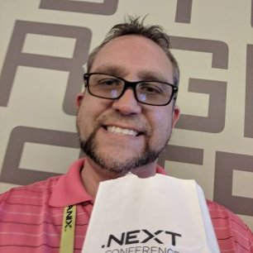
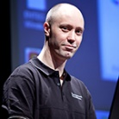
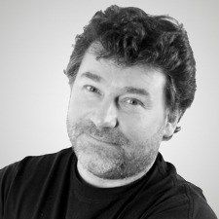
Stand on the Shoulders of others
Jeff Downs
@edtech_jeff
Johan Arwidmark
@jarwidmark
Mikael Nystrom
@mikael_nystrom

